Slide 1

Logistic Regression

Slide 2
What is Logistic Regression
Logistic Regression is the supervised machine learning algorithm model which will try to categorize or classify the binary event
There are different types of Logistic regression like Binomial, Ordinal and Multinomial

Slide 3

Types of Logistic Regression
Binary logistic regression is the one where we have only 2 classes (yes/no, true/ false)
Ordinal regression is used to predict the dependent variable with ‘ordered’ multiple categories and independent variables. In other words, it is used to facilitate the interaction of dependent variables (having multiple ordered levels) with one or more independent variables.
Multinomial regression is an extension of logistic regression, which analyzes dichotomous (binary) dependents.

Slide 4
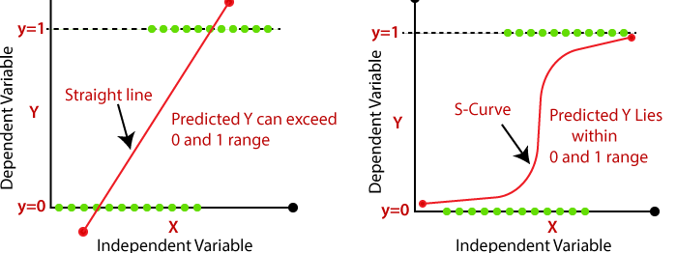
Linear regression v/s logistic regression

Slide 5
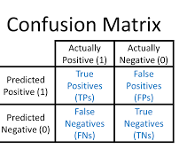
Classification Metrics
Article Link: https://medium.com/analytics-vidhya/evaluation-metrics-for-classification-problems-with-implementation-in-python-a20193b4f2c3

